Slide 1
Final Thoughts
AI2C Tech Intro

Slide 2
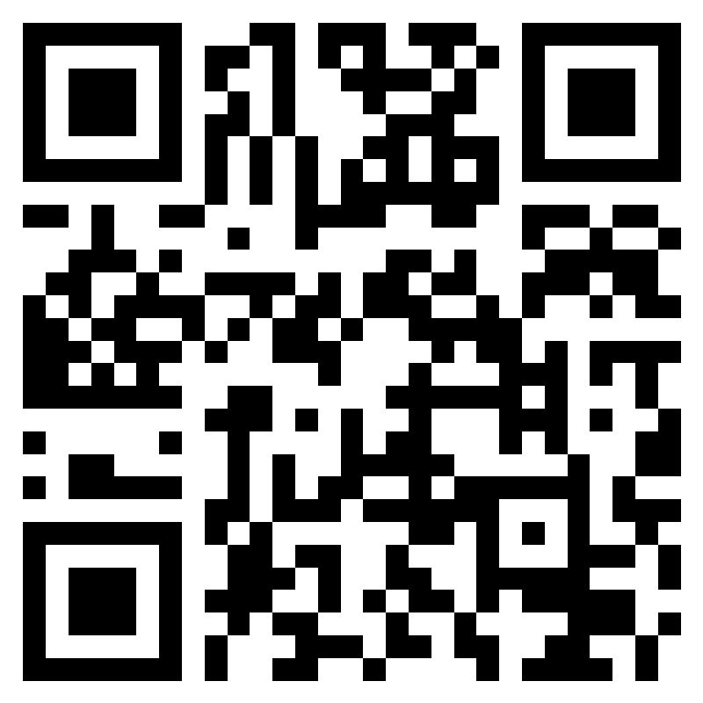
AAR
https://forms.office.com/r/RvNFP3m9Ck
Open until 1900 on 22-Aug-25

Slide 3
New Teams!
Team 1
Team 2
Team OIC:
Team NCOIC:
Team OIC:
Team NCOIC:

Slide 4
Volunteering Friday
Place 1
Place 2
Address
Time
“Uniform”
Tasks
Address
Time
“Uniform”
Tasks

Slide 5
Others
Course/lesson refinement
Kata development
Friday recitation development
Help move to new space

